Slide 1


FULL STACK WEB DEVELOPMENT WITH JAVA
Lecture-3
(Servlet)

Slide 2
Today’s Agenda
LifeCycle Of a Servlet
Introduction To GenericServlet class
Creating The Sevlet.

Slide 3
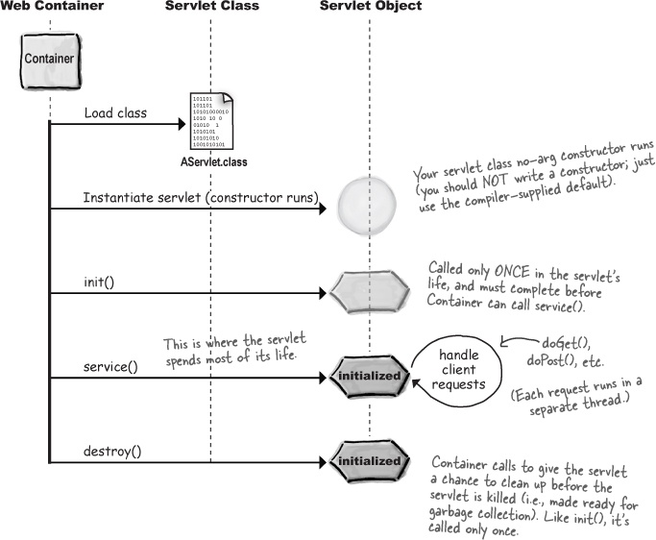
SERVLET LIFE-CYCLE

Slide 4
SERVLET LIFE-CYCLE
The lifecycle of a servlet is controlled by the container in which the servlet has been deployed. When a request is mapped to a servlet, the container performs the following steps.
1. If an instance of the servlet does not exist, the web container does the following tasks:
Loads the servlet class.
Creates an instance of the servlet class.
Initializes the servlet instance by calling the init( ) method.
Invokes the service( ) method, passing request and response objects.
2. If the servlet instance is present then first 3 tasks are not repeated , rather only the fourth part is re-executed i.e. only service( ) method is called for every next request.
3. Finally if the container needs to remove the servlet , it calls the servlet’s destroy( ) method

Slide 5
CREATING SERVLET
Although we can implement the javax.servlet.Servlet interface while developing our own servlet, but this practice is rarely followed.
Rather Java has provided us two implementation classes of Servlet interface which we must extend . They are called:
GenericServlet
HttpServlet
The class GenericServlet implements Servlet interface and the class HttpServlet extends GenericServlet class

Slide 6
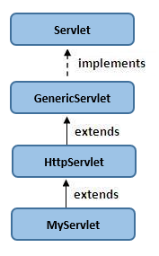
SERVLET HIERARCHY

Slide 7
THE GENERICSERVLET CLASS
GenericServlet implements Servlet interface and provides implementation for all it’s method except service() method hence it is abstract.
GenericServlet class defines a protocol-independent(HTTP-less) servlet. However while building a website or an online application, we may want to have Http protocol, in that case we must extend HttpServlet instead of GenericServlet
Developing Servlet by extending GenericServlet is very easy because we have to provide implementation only for service()method.

Slide 8
THE service( ) METHOD
The prototype of service( ) method is :
public void service (ServletRequest req, ServletResponse resp) throws ServletException,IOException

Slide 9
THE service( ) METHOD
This method is automatically called by the server whenever request for a GenericServlet arrives
The service() method accepts two parameters:
A ServletRequestObject
A SerlvetResponseObject
The ServletRequest object allows to read data provided by
the client request and the ServletResponse object is used to
send the response to the client

Slide 10
FIRST SERVLET
import java.io.*;
import javax.servlet.*;
public class MyFirstServlet extends GenericServlet
{
public void service (ServletRequest req, ServletResponse resp) throws ServletException,IOException
{

Slide 11
FIRST SERVLET
resp.setContentType(“text/html”);
PrintWriter pw = resp.getWriter();
pw.println("<html>");
pw.println("<body>");
pw.println("<h2>Welcome To Servlet World!</h2>");
pw.println("</body>");
pw.println("</html>");
pw.close();
}
}

Slide 12
COMPILING THE PROGRAM
Before we can compile the program we need to set the servlet-api.jar file in our classpath.
This is because the package javax.servlet is in this jar file.
The file servlet-api.jar is available in the lib folder of Tomcat.
So assuming Tomcat is in d:\ drive , our command to set classpath would be :
d:\Apache Software Foundation\Tomcat 8.0\lib\servlet-api.jar ;.;%classpath%

Slide 13
COMPILING THE PROGRAM
Now we can compile the code using usual javac command i.e.:
javac MyFirstServlet.java
Doing this will generate the MyFirstServlet.class file which we will have to deploy in our web-server

Slide 14
DEPLOYING THE SERVLET
To deploy the servlet in our web-server we need to do the following:
Create an appropriate directory structure
Design the web.xml file
Place the .class file in you appication’s classes sub-directory

Slide 15
CREATING THE DIRECTORY
For creating web application we should follow standard directory structure provided by Sun and is server independent.
According to this
An application contain application root folder with any name.
Under root folder a sub folder is required with a name WEB-INF.
Under WEB-INF two sub folder are required called classes and lib.
All jar files placed inside lib folder.
All .class files including servlet’s .class file are placed inside classes folder.
All image, html, .js, jsp etc files are placed inside application root folder.
Also under WEB-INF folder we need to place the web.xml file

Slide 16
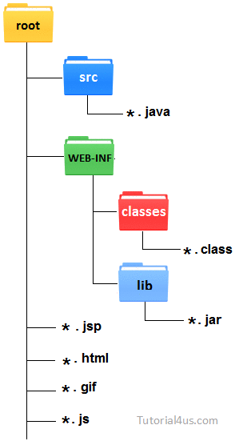
CREATING THE DIRECTORY

Slide 17
THE web.xml FILE
Java web applications use a deployment descriptor file to determine how URLs map to servlets.
This file is named web.xml, and resides in the app's WEB-INF/ directory and is a part of the servlet standard for web applications.

Slide 18
DESIGNING THE web.xml FILE
<web-app>
<servlet>
<servlet-class>MyFirstServlet</servlet-class>
<servlet-name>MyFirstServlet</servlet-name>
</servlet>
<servlet-mapping>
<servlet-name>MyFirstServlet</servlet-name>
<url-pattern>/MyFirstServlet</url-pattern>
</servlet-mapping>
</web-app>

Slide 19
CONFIGURING THE SERVLET
Once the directory structure is in place , then we can copy the MyFirstServlet.class file inside the classes folder of our application.
Placing .class file inside the classes folder is a compulsory requirement for our servlet.

Slide 20
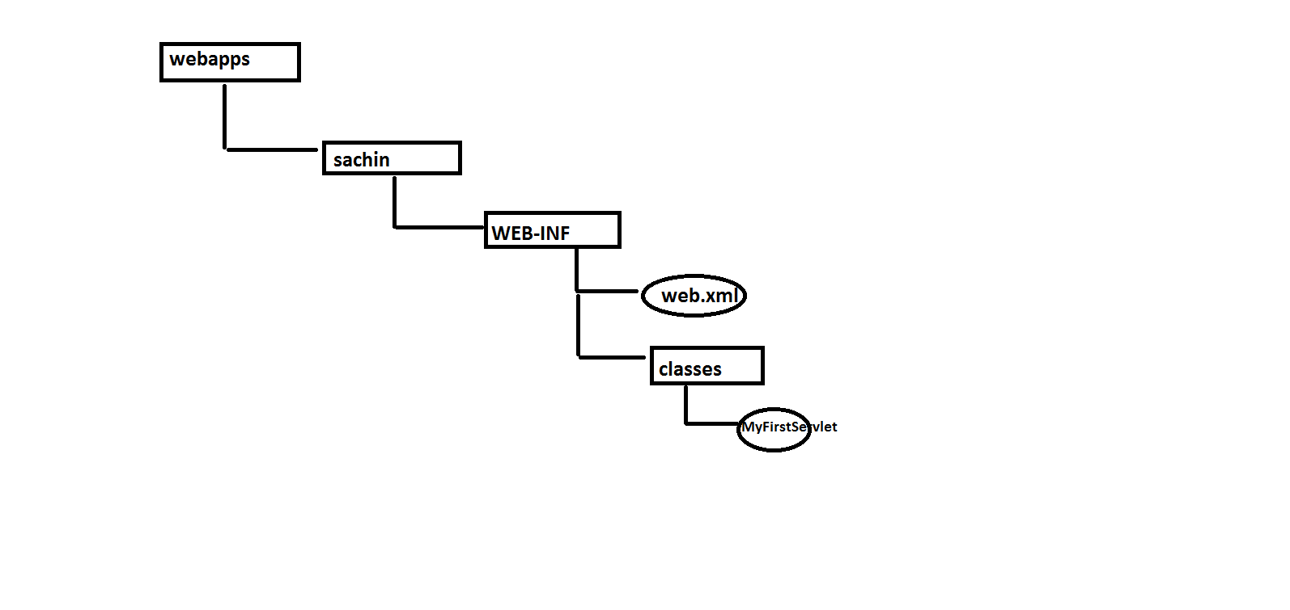
CONFIGURING THE SERVLET

Slide 21
RUN THE APPLICATION
After all the deployment has been done we need to test our servlet and for this we need to do the following:
Start the Tomcat server by clicking on the Tomcat7.exe file found inside the Tomcat’s bin folder.
Open the browser and type the following url:
http://localhost:1978/sachin/MyFirstServlet

Slide 22
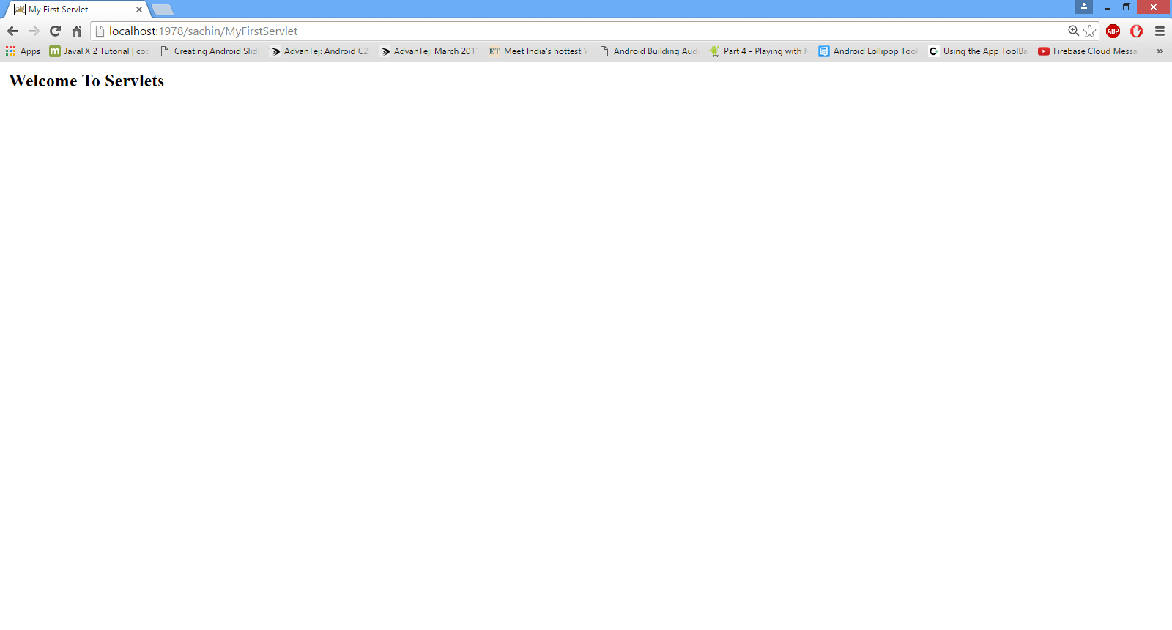
RUN THE APPLICATION

Slide 23

End Of Lecture
For any queries mail us @: scalive4u@gmail.com
Call us @ : 0755-4271659, 7879165533
Agenda for Next Lecture:
Introduction to HttpServlet
Differences with GenericServlet
Introduction to doGet( ) and doPost( )
Developing Servlet by extending HttpServlet

